Slide 1
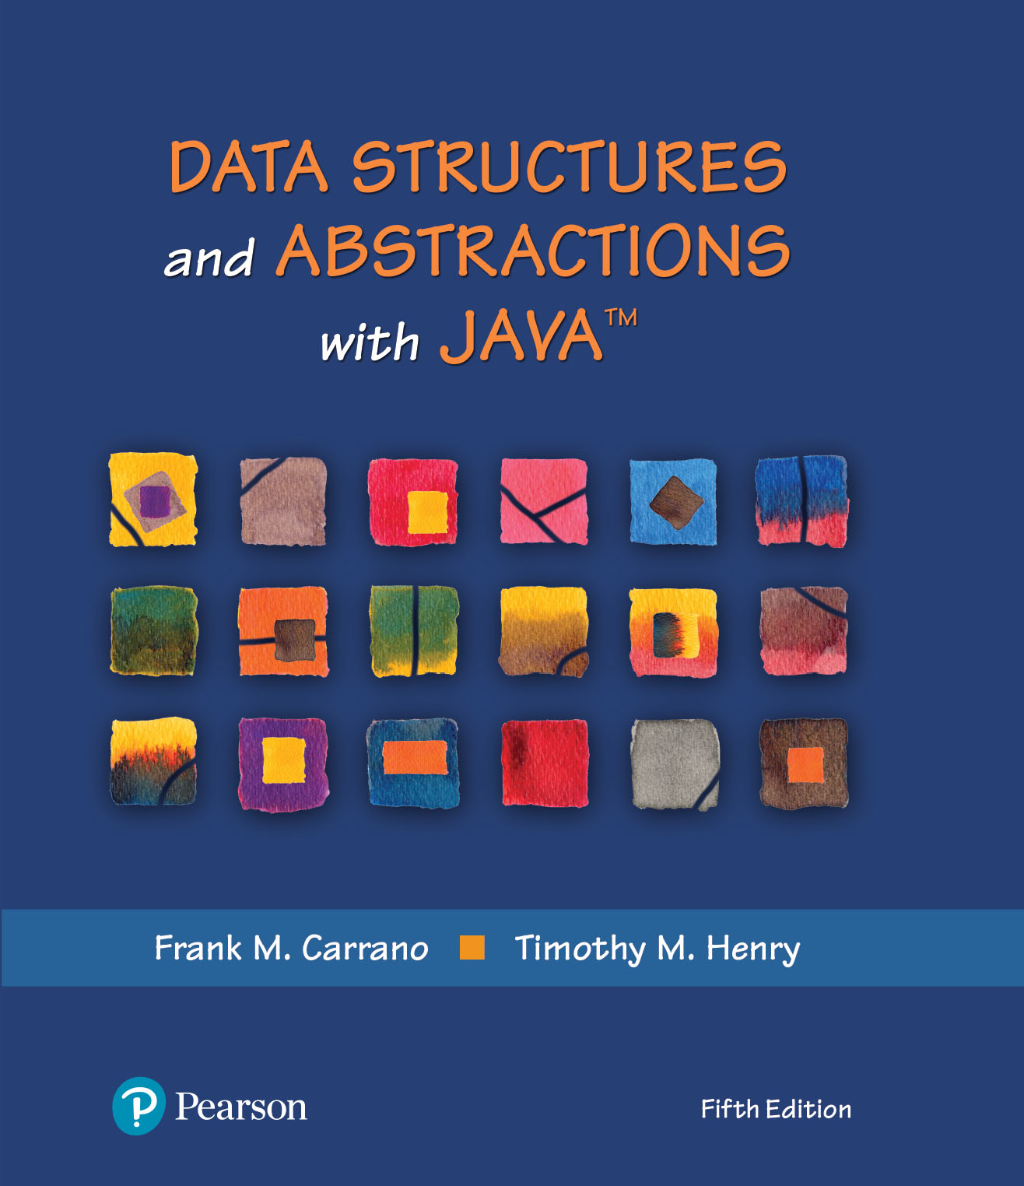
Data Structures and Abstractions with Java™
5th Edition
Module 11 – Iterators and Interfaces
Including:
Java Interlude 4 – Iterators
Chapter 13 - Iterators

Slide 2
What Is an Iterator?
An object that traverses a collection of data
During iteration, each data item is considered once
Possible to modify item as accessed
Should implement as a distinct class that interacts with the ADT

Slide 3
The Java Interface Iterator
package java.util;
public interface Iterator<T>
{
/** Detects whether this iterator has completed its traversal
and gone beyond the last entry in the collection of data.
@return True if the iterator has another entry to return. */
public boolean hasNext();
/** Retrieves the next entry in the collection and
advances this iterator by one position.
@return A reference to the next entry in the iteration,
if one exists.
@throws NoSuchElementException if the iterator had reached the
end already, that is, if hasNext() is false. */
public T next();
/** Removes from the collection of data the last entry that
next() returned. A subsequent call to next() will behave
as it would have before the removal.
Precondition: next() has been called, and remove() has not
been called since then. The collection has not been altered
during the iteration except by calls to this method.
@throws IllegalStateException if next() has not been called, or
if remove() was called already after the last call to next().
@throws UnsupportedOperationException if the iterator does
not permit a remove operation. */
public void remove(); // Optional method
} // end Iterator

Slide 4
The Java Interface Iterator
FIGURE J4-1 Possible positions of an iterator’s cursor within a collection

Slide 5
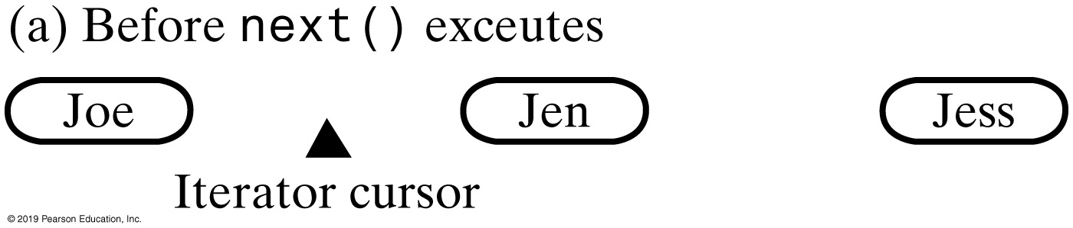
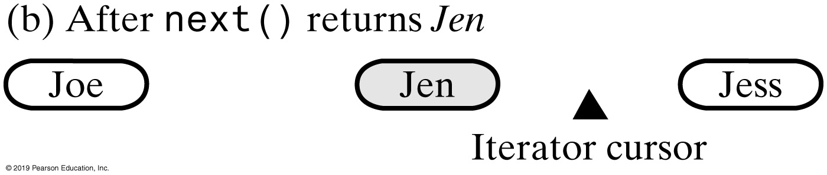
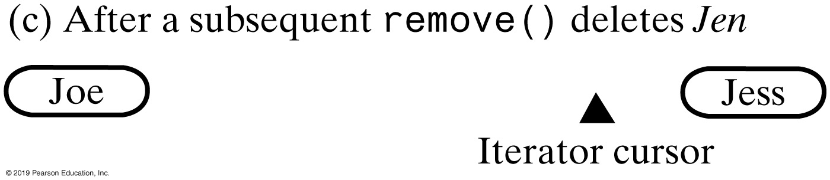
The Java Interface Iterator
FIGURE J4-2 Effect on a collection’s iterator by a call to next and subsequent call to remove

Slide 6
The Interface Iterable
package java.lang;
public interface Iterable<T>
{
/** @return An iterator for a collection of objects of type T. */
Iterator<T> iterator();
} // end Iterable
LISTING JI5-2 The interface java.lang.Iterable

Slide 7
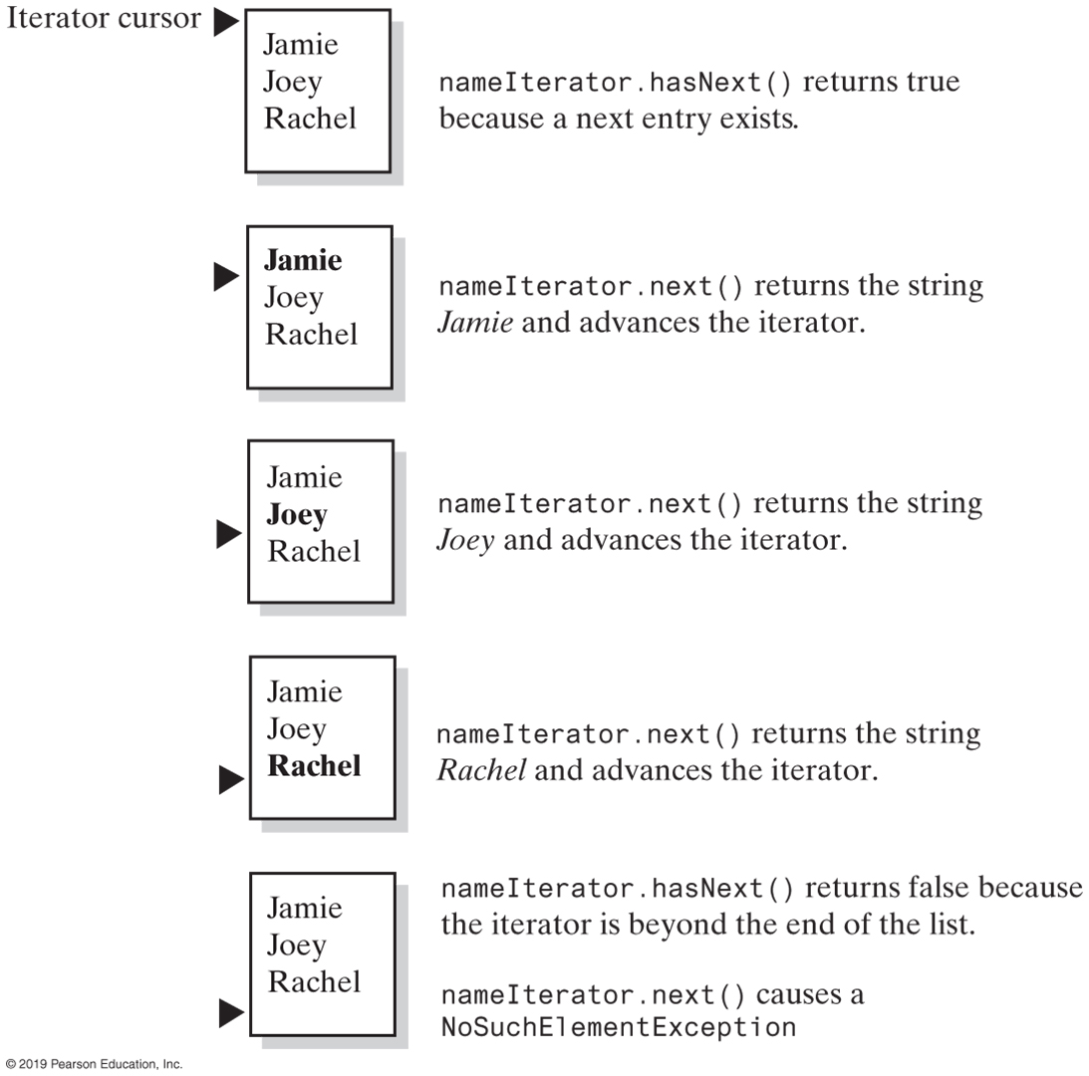
Using the Java Interface Iterator
FIGURE J4-3 The effect of the iterator methods hasNext and next on a list

Slide 8
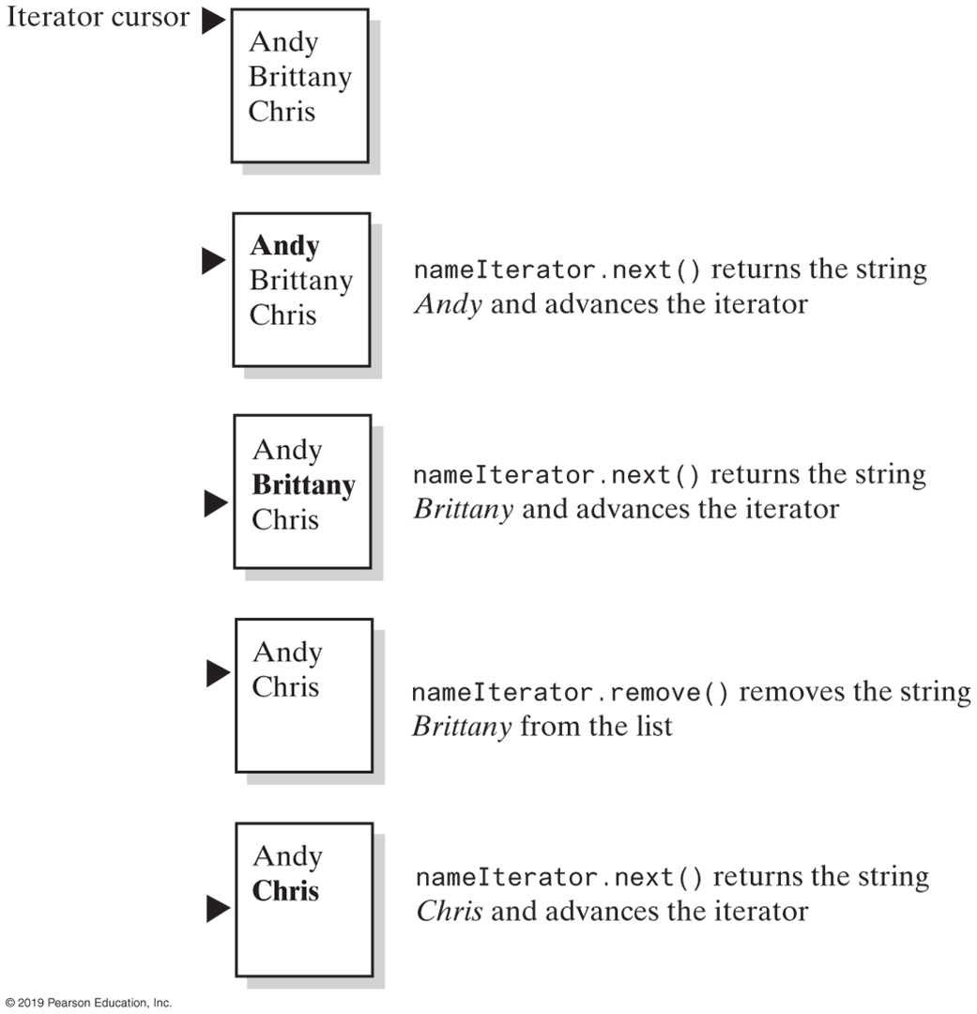
Using the Java Interface Iterator
FIGURE J4-4 The effect of the iterator methods next and remove on a list

Slide 9
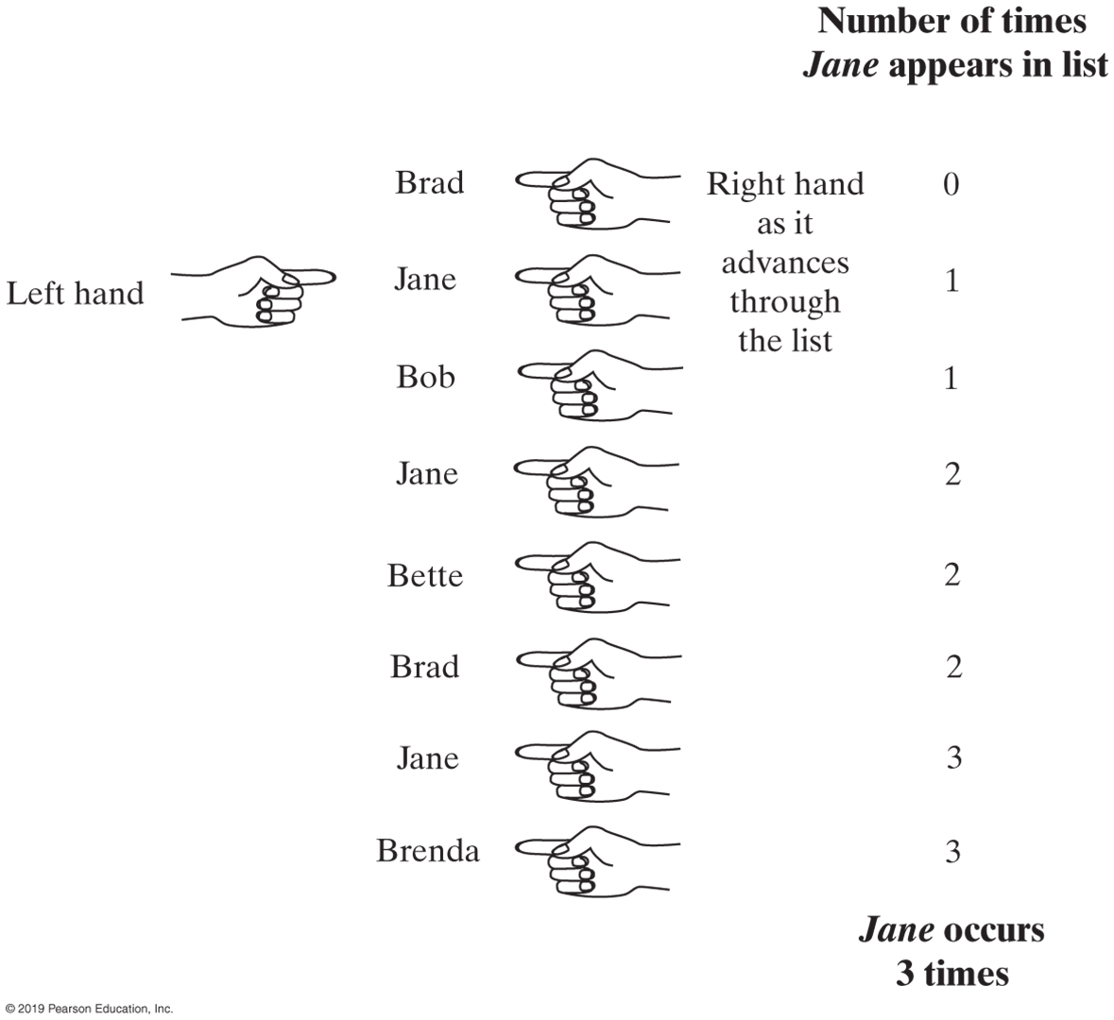
Using the Java Interface Iterator
FIGURE J4-5 Counting the number of times that Jane appears in a list of names

Slide 10
Multiple Iterators
Iterator<String> nameIterator = namelist.iterator();
while (nameIterator.hasNext())
{
String currentName = nameIterator.next();
int nameCount = 0;
Iterator<String> countingIterator = namelist.iterator();
while (countingIterator.hasNext())
{
String nextName = countingIterator.next();
if (currentName.equals(nextName))
nameCount++;
} // end while
System.out.println(currentName + " occurs " + nameCount + " times.");
} // end while
Code that counts the occurrences of each name

Slide 11
LISTING JI4-3 Java’s interface java.util.ListIterator (Part 1)
package java.util;
public interface ListIterator<T> extends Iterator<T>
{
/** Detects whether this iterator has gone beyond the last
entry in the list.
@return True if the iterator has another entry to return when
traversing the list forward; otherwise returns false. */
public boolean hasNext();
/** Retrieves the next entry in the list and
advances this iterator by one position.
@return A reference to the next entry in the iteration,
if one exists.
@throws NoSuchElementException if the iterator is at the end,
that is, if hasNext() is false. */
public T next();
/** Removes from the list the last entry that either next()
or previous() has returned.
Precondition: next() or previous() has been called, but the
iterator's remove() or add() method has not been called
since then. That is, you can call remove only once per
call to next() or previous(). The list has not been altered
during the iteration except by calls to the iterator's
remove(), add(), or set() methods.
@throws IllegalStateException if next() or previous() has not
been called, or if remove() or add() has been called
already after the last call to next() or previous().
@throws UnsupportedOperationException if the iterator does not
permit a remove operation. */
public void remove(); // Optional method
These three methods are in the interface Iterator; they are duplicated here for reference and to show new behavior for remove.

Slide 12
LISTING JI4-3 Java’s interface java.util.ListIterator (Part 2)
/** Detects whether this iterator has gone before the first
entry in the list.
@return True if the iterator has another entry to visit when
traversing the list backward; otherwise returns false. */
public boolean hasPrevious();
/** Retrieves the previous entry in the list and moves this
iterator back by one position.
@return A reference to the previous entry in the iteration, if
one exists.
@throws NoSuchElementException if the iterator has no previous
entry, that is, if hasPrevious() is false. */
public T previous();
/** Gets the index of the next entry.
@return The index of the list entry that a subsequent call to
next() would return. If next() would not return an entry
because the iterator is at the end of the list, returns
the size of the list. Note that the iterator numbers
the list entries from 0 instead of 1. */
public int nextIndex();
/** Gets the index of the previous entry.
@return The index of the list entry that a subsequent call to
previous() would return. If previous() would not return
an entry because the iterator is at the beginning of the
list, returns −1. Note that the iterator numbers the
list entries from 0 instead of 1. */
public int previousIndex();

Slide 13
LISTING JI4-3 Java’s interface java.util.ListIterator (Part 3)
/** Adds an entry to the list just before the entry, if any,
that next() would have returned before the addition. This
addition is just after the entry, if any, that previous()
would have returned. After the addition, a call to
previous() will return the new entry, but a call to next()
will behave as it would have before the addition.
Further, the addition increases by 1 the values that
nextIndex() and previousIndex() will return.
@param newEntry An object to be added to the list.
@throws ClassCastException if the class of newEntry prevents the
addition to the list.
@throws IllegalArgumentException if some other aspect of
newEntry prevents the addition to the list.
@throws UnsupportedOperationException if the iterator does not
permit an add operation. */
public void add(T newEntry); // Optional method
/** Replaces the last entry in the list that either next()
or previous() has returned.
Precondition: next() or previous() has been called, but the
iterator's remove() or add() method has not been called since then.
@param newEntry An object that is the replacement entry.
@throws ClassCastException if the class of newEntry prevents the
addition to the list.
@throws IllegalArgumentException if some other aspect of newEntry
prevents the addition to the list.
@throws IllegalStateException if next() or previous() has not been called,
or if remove() or add() has been called already
after the last call to next() or previous().
@throws UnsupportedOperationException if the iterator does not permit a set operation. */
public void set(T newEntry); // Optional method
} // end ListIterator

Slide 14
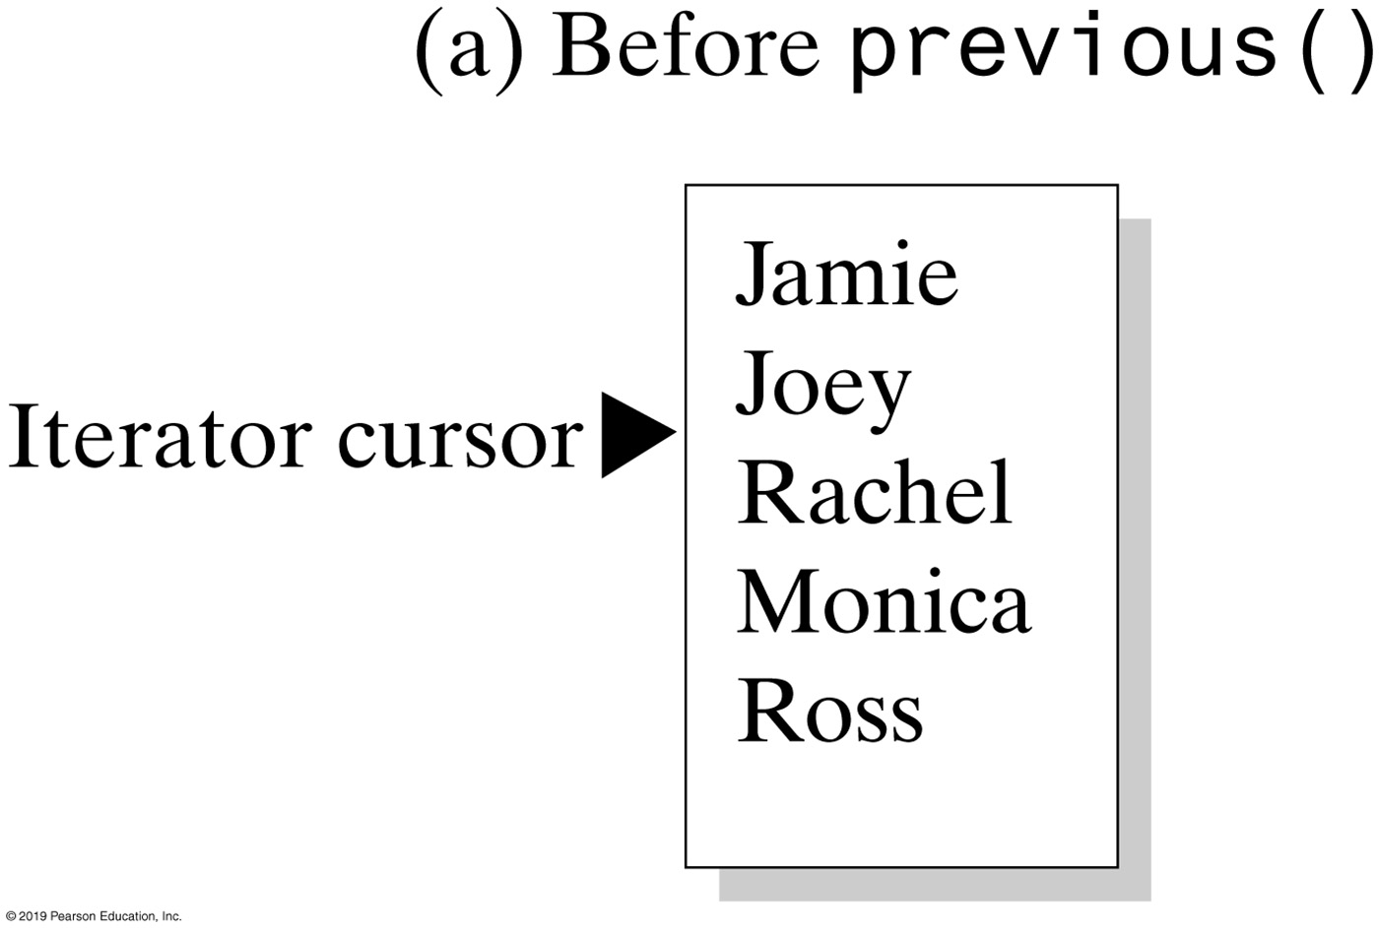
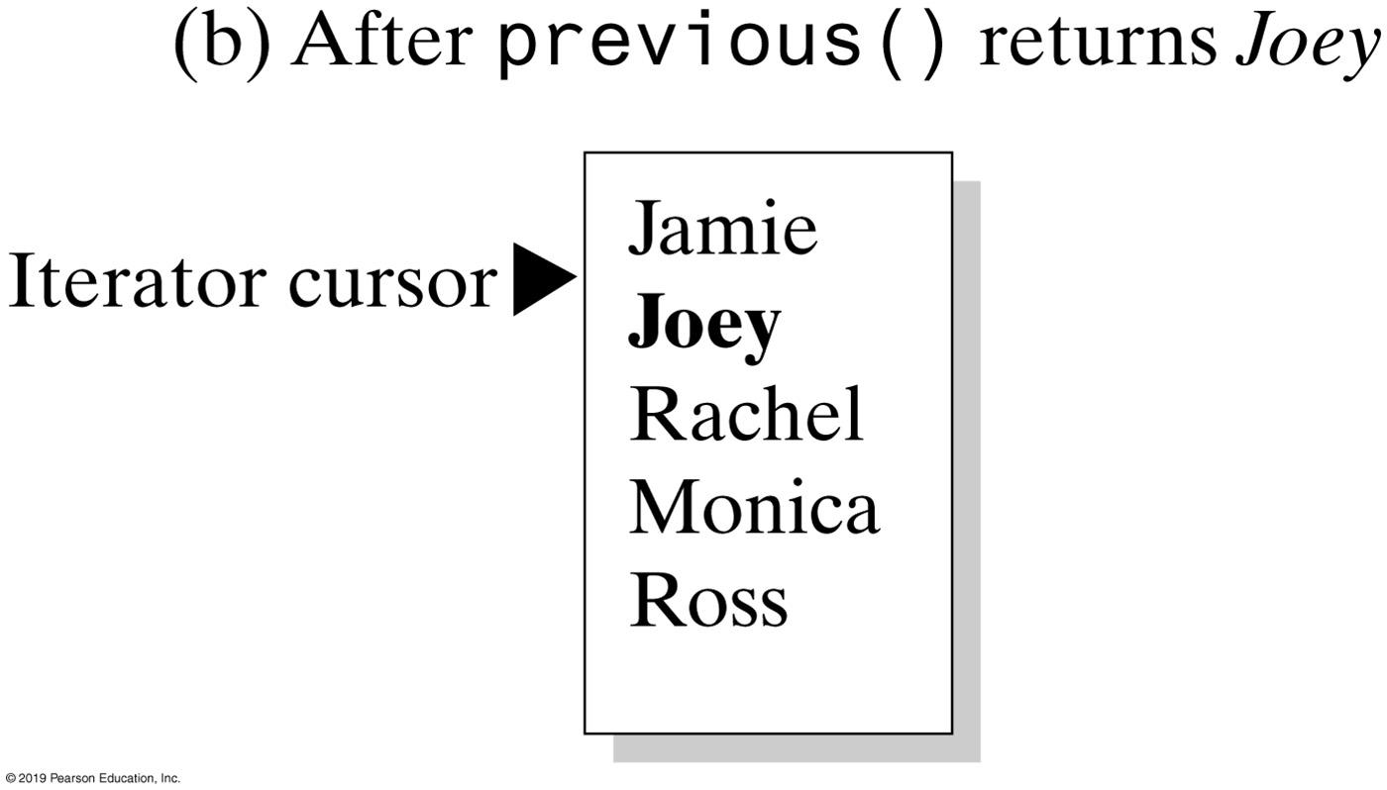
Using the Java Interface ListIterator
FIGURE J4-6 The effect of a call to previous on a list

Slide 15
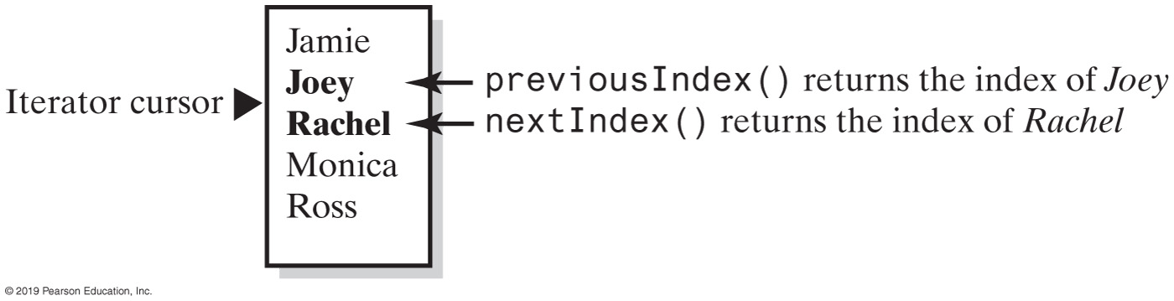
Using the Java Interface ListIterator
FIGURE J4-7 The indices returned by the methods nextIndex and previousIndex

Slide 16
The Interface List Revisited
Method set replaces entry that either next or previous just returned.
Method add inserts an entry into list just before iterator’s current position
Method remove removes list entry that last call to either next or previous returned

Slide 17
Implementing an Iterator Class
Two techniques. The iterator class is defined
Inside the data structure class (as an inner class)
Maintains the data structure’s encapsulation
Called and internal iterator
Outside the data structure class
Allows the client to specify the name (and number) of the iterator objects
The iterator class can be used by multiple data structures
Implementation unencapsulates the data structure
Called an external iterator

Slide 18
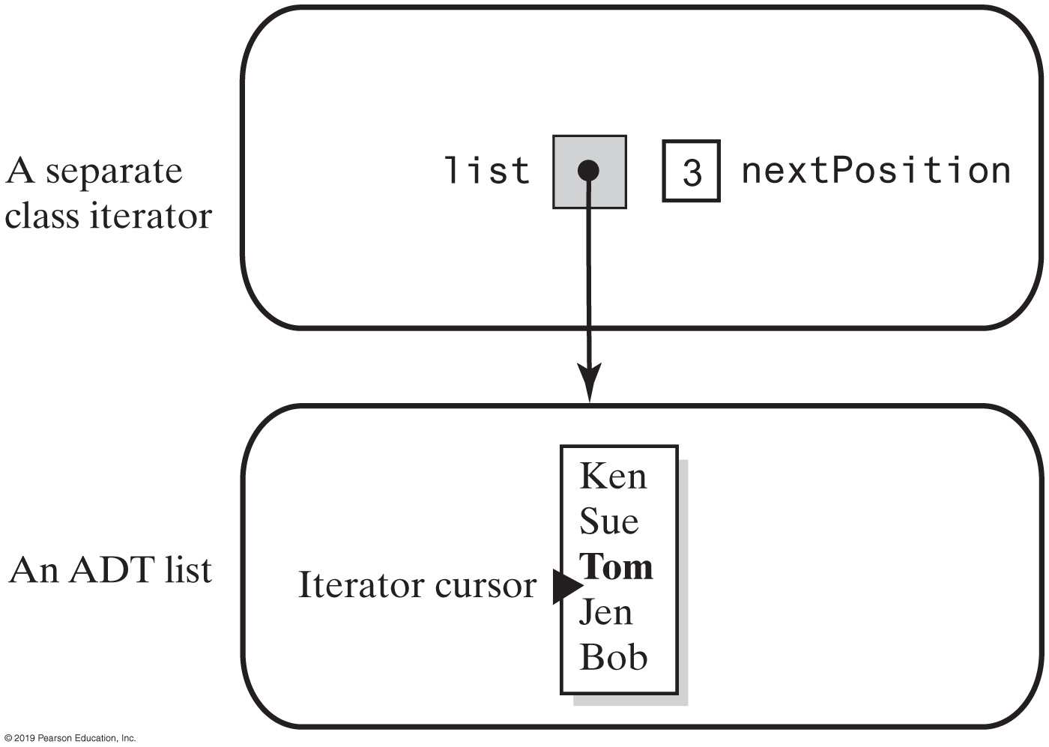
Separate Class Iterator (External Iterator)
Figure 13-1 A separate class iterator with a reference to an ADT, an indicator of its position within the iteration, and no knowledge of the ADT’s implementation
Notes:
FIGURE 13-1
A separate class iterator with a reference to an ADT, an indicator of its position within the iteration, and no knowledge of the ADT’s implementation

Slide 19
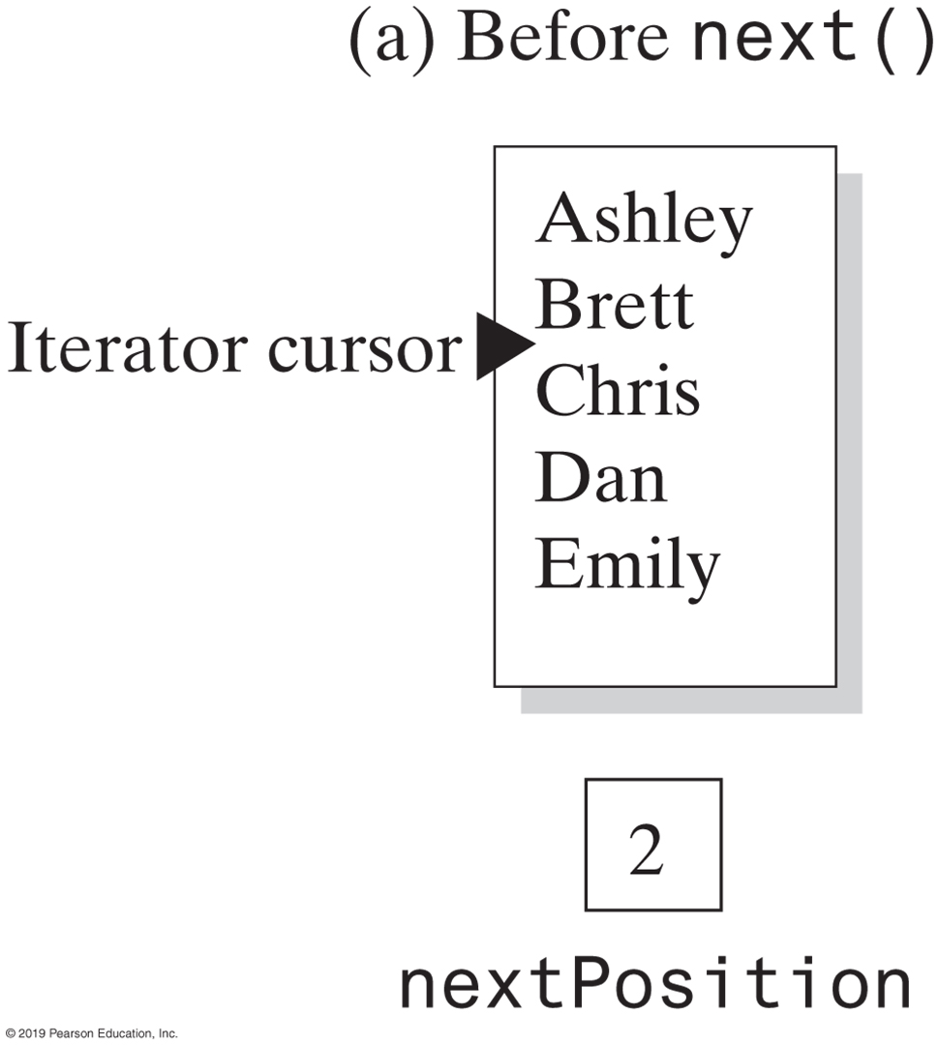
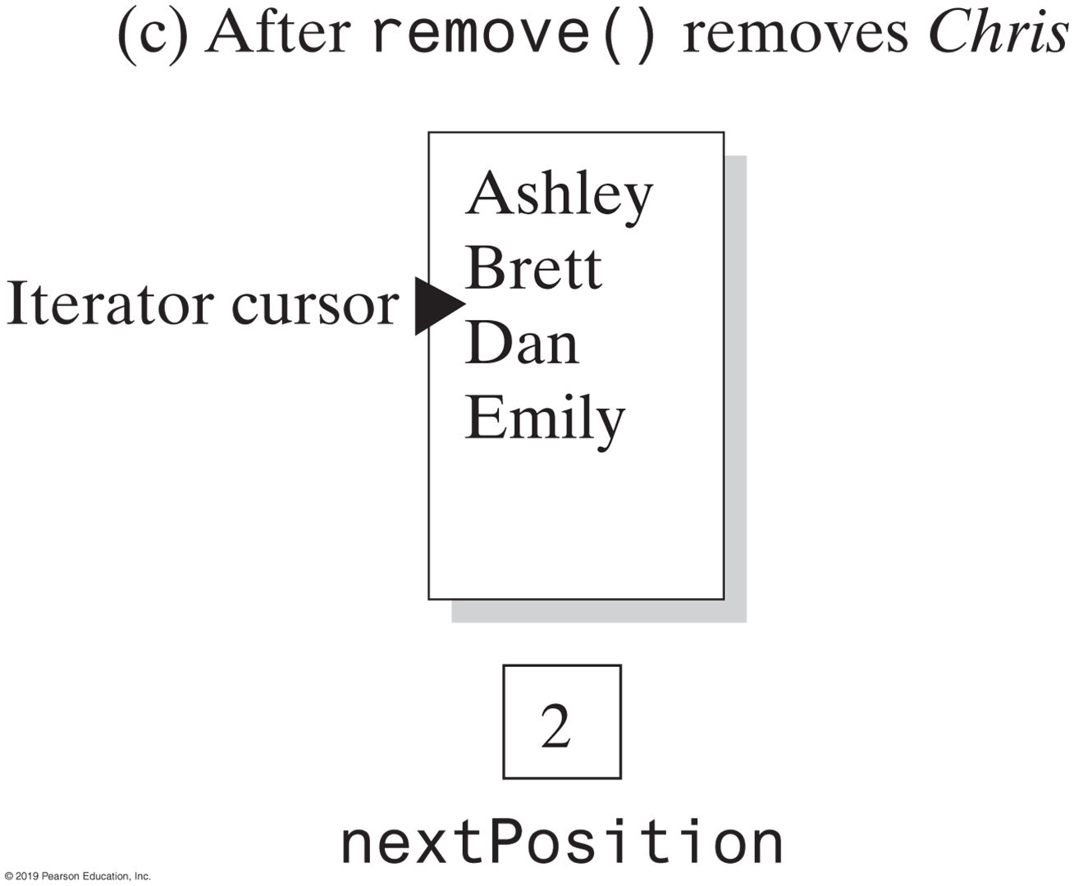
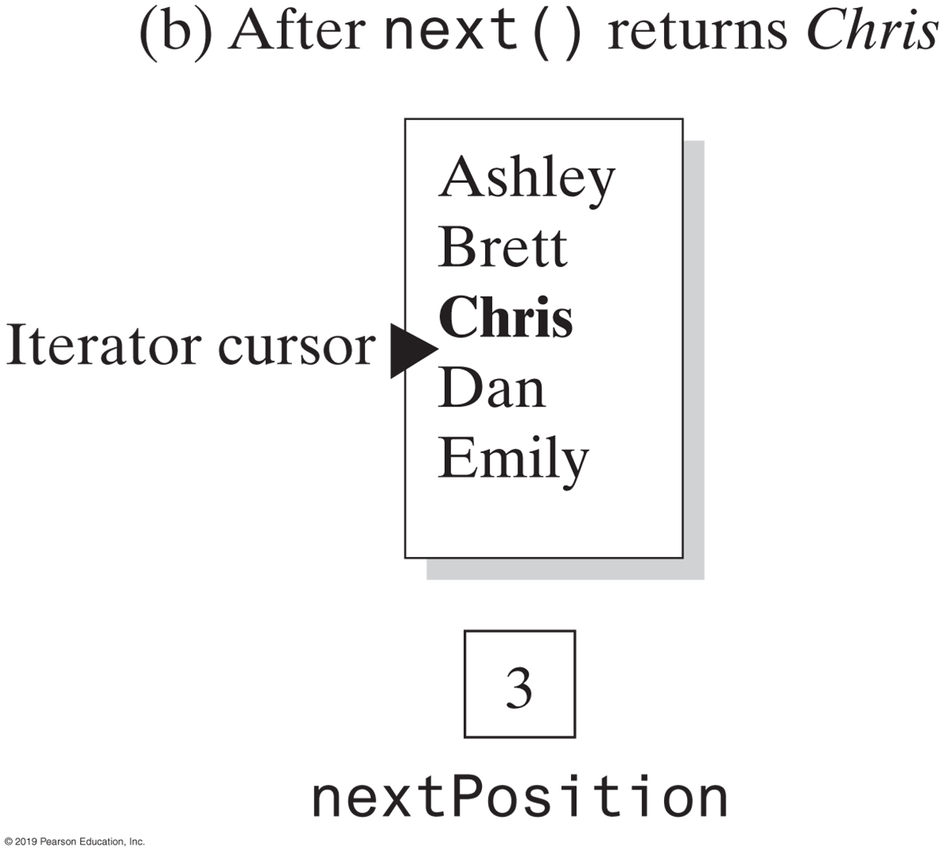
Separate Class Iterator
FIGURE 13-2 Changes to a list and nextPosition when removing Chris from the list

Slide 20
Separate Class Iterator
/** A class that represents an iterator for the ADT list. */
public class SeparateIterator<T> implements Iterator<T>
{
private ListInterface<T> list;
private int nextPosition; // Position of entry last returned by next()
private boolean wasNextCalled; // Needed by remove
public SeparateIterator(ListInterface<T> myList)
{
list = myList;
nextPosition = 0;
wasNextCalled = false;
} // end constructor
/* < Implementations of the methods hasNext, next, and remove go here. >
. . . */
} // end SeparateIterator
LISTING 13-1 An outline of the class SeparateIterator

Slide 21
Separate Class Iterator
public boolean hasNext()
{
return nextPosition < list.getLength();
} // end hasNext
Implementation of hasNext

Slide 22
Separate Class Iterator
public T next()
{
if (hasNext())
{
wasNextCalled = true;
nextPosition++;
return list.getEntry(nextPosition);
}
else
throw new NoSuchElementException("Illegal call to next(); " +
"iterator is after end of list.");
} // end next
Implementation of next

Slide 23
Separate Class Iterator
public void remove()
{
if (wasNextCalled)
{
// nextPosition was incremented by the call to next(), so
// it is the position number of the entry to be removed
list.remove(nextPosition);
nextPosition--; // A subsequent call to next() must be
// unaffected by this removal
wasNextCalled = false; // Reset flag
}
else
throw new IllegalStateException("Illegal call to remove(); " +
"next() was not called.");
} // end remove
Implementation of remove

Slide 24
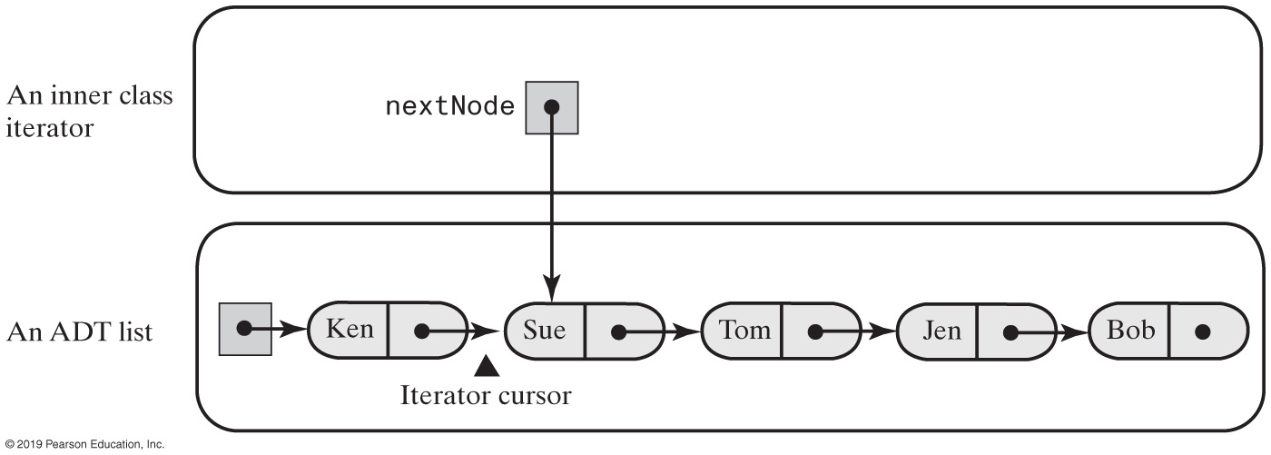
Inner Class Iterator (Internal Iterator)
FIGURE 13-3 An inner class iterator with direct access to the linked chain that implements the ADT

Slide 25
Inner Class Iterator
/** An interface for the ADT list that has an iterator. */
public interface ListWithIteratorInterface<T>
extends ListInterface<T>, Iterable<T>
{
public Iterator<T> getIterator();
} // end ListWithIteratorInterface
LISTING 13-2 The interface ListWithIteratorInterface

Slide 26
Inner Class Iterator (Part 1)
/** A class that implements the ADT list by using a chain of linked nodes.
The list has an iterator. The class is similar to LList. */
public class LinkedListWithIterator<T> implements ListWithIteratorInterface<T>
{
private Node firstNode;
private int numberOfEntries;;
public LinkedListWithIterator()
{
initializeDataFields();
} // end default constructor
/* < Implementations of the methods of the ADT list go here;
you can see them in Chapter 12, beginning at Segment 12.7 >
. . . */
public Iterator<T> iterator()
{
return new IteratorForLinkedList();
} // end iterator
public Iterator<T> getIterator()
{
return iterator();
} // end getIterator
LISTING 13-3 An outline of the class LinkedListWithIterator

Slide 27
Inner Class Iterator (Part 2)
private class IteratorForLinkedList implements Iterator<T>
{
private Node nextNode;
private IteratorForLinkedList()
{
nextNode = firstNode;
} // end default constructor
// Implementations of the methods in the interface Iterator go here.
} // end IteratorForLinkedList
private class Node
{
// Implementations of the methods in inner class Node go here.
} // end Node
} // end LinkedListWithIterator
LISTING 13-3 An outline of the class LinkedListWithIterator

Slide 28
Inner Class Iterator
public T next()
{
T result;
if (hasNext())
{
result = nextNode.getData();
nextNode = nextNode.getNextNode(); // Advance iterator
}
else
throw new NoSuchElementException("Illegal call to next(); " +
"iterator is after end of list.");
return result; // Return next entry in iteration
} // end next
The method next.

Slide 29
Inner Class Iterator
public boolean hasNext()
{
return nextNode != null;
} // end hasNext
The method hasNext

Slide 30
Inner Class Iterator
public void remove()
{
throw new UnsupportedOperationException("remove() is not supported " +
"by this iterator");
} // end remove
The method remove.

Slide 31
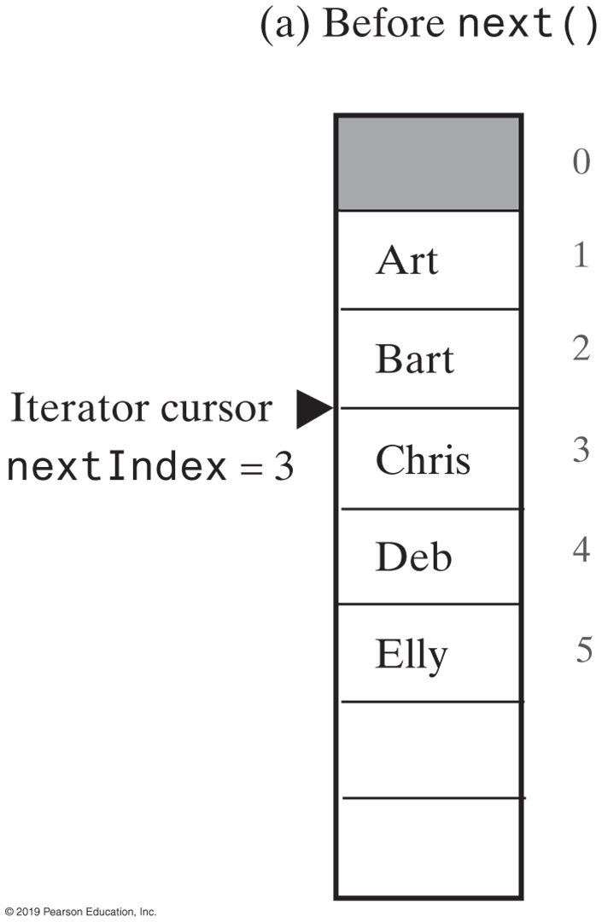
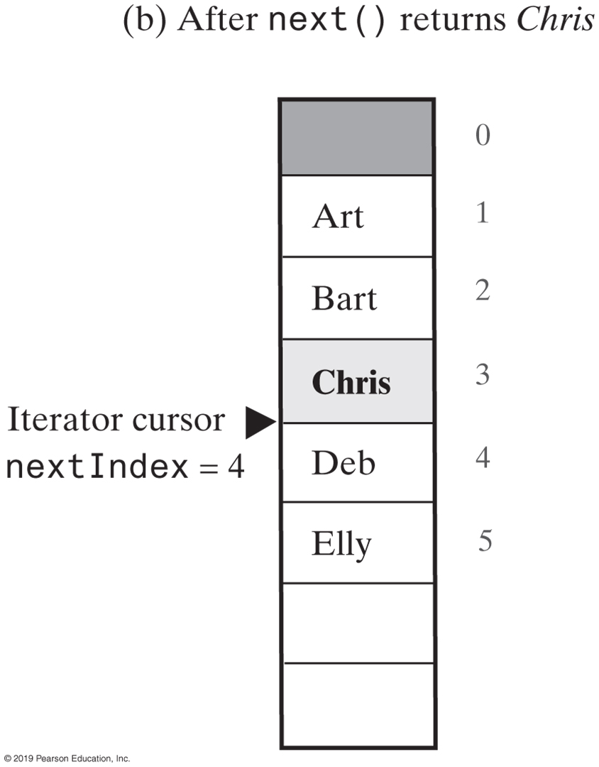
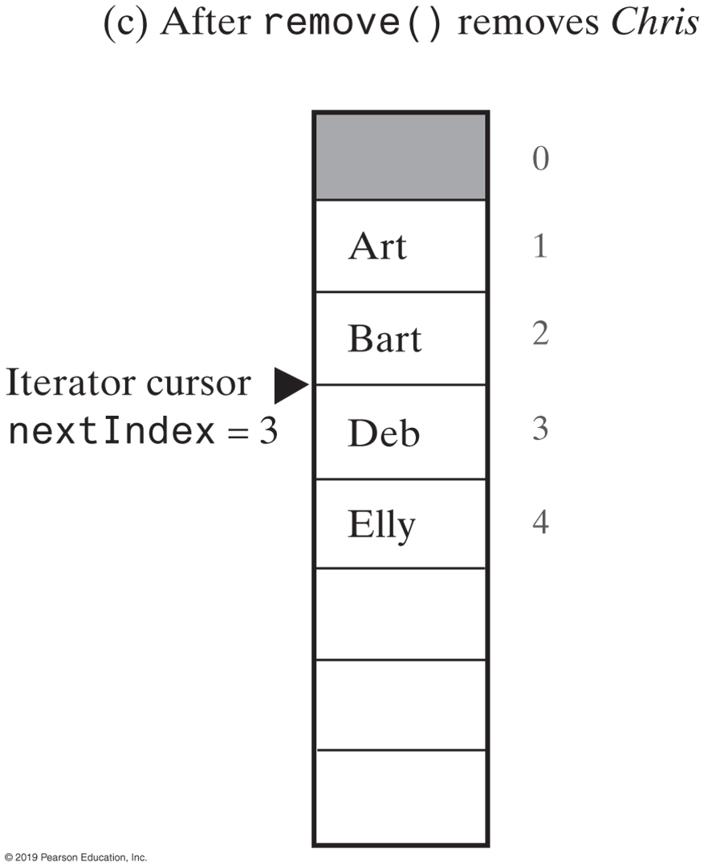
Iterators for Array-Based Lists
FIGURE 13-4 Changes to the array of list entries and nextIndex when removing Chris from the list

Slide 32
Iterators for Array-Based Lists (Part 1)
/** A class that implements the ADT list by using a resizable array and
gives it an iterator. */
public class ArrayListWithIterator<T> implements ListWithIteratorInterface<T>
{
private T[] list; // Array of list entries; ignore list[0]
private int numberOfEntries;
private boolean integrityOK = false;
private static final int DEFAULT_CAPACITY = 25;
private static final int MAX_CAPACITY = 10000;
public ArrayListWithIterator()
{
this(DEFAULT_CAPACITY);
} // end default constructor
LISTING 13-4 An outline of the class ArrayListWithIterator

Slide 33
Iterators for Array-Based Lists (Part 2)
public ArrayListWithIterator(int initialCapacity)
{
integrityOK = false;
// Is initialCapacity too small?
if (initialCapacity < DEFAULT_CAPACITY)
initialCapacity = DEFAULT_CAPACITY;
else // Is initialCapacity too big?
checkCapacity(initialCapacity);
// The cast is safe because the new array contains null entries
@SuppressWarnings("unchecked")
T[] tempList = (T[])new Object[initialCapacity + 1];
list = tempList;
numberOfEntries = 0;
integrityOK = true;
} // end constructor
/* < Implementations of the methods of the ADT list go here;
you can see them in Chapter 11, beginning at Segment 11.5. */
LISTING 13-4 An outline of the class ArrayListWithIterator

Slide 34
Iterators for Array-Based Lists (Part 3)
public Iterator<T> iterator()
{
return new IteratorForArrayList();
} // end iterator
public Iterator<T> getIterator()
{
return iterator();
} // end getIterator
private class IteratorForArrayList implements Iterator<T>
{
private int nextIndex; // Index of next entry in the iteration
private boolean wasNextCalled; // Needed by remove
private IteratorForArrayList()
{
nextIndex = 1; // Iteration begins at list's first entry
wasNextCalled = false;
} // end default constructor
// Implementations of the methods in the interface Iterator go here.
} // end IteratorForArrayList
} // end ArrayListWithIterator
LISTING 13-4 An outline of the class ArrayListWithIterator

Slide 35
Iterators for Array-Based Lists
public boolean hasNext()
{
return nextIndex <= numberOfEntries;
} // end hasNext
Method hasNext

Slide 36
Iterators for Array-Based Lists
public T next()
{
checkIntegrity();
if (hasNext())
{
wasNextCalled = true;
T nextEntry = list[nextIndex];
nextIndex++; // Advance iterator
return nextEntry;
}
else
throw new NoSuchElementException("Illegal call to next(); " +
"iterator is after end of list.");
} // end next
Method next

Slide 37
Iterators for Array-Based Lists
public void remove()
{
checkIntegrity();
if (wasNextCalled)
{
// nextIndex was incremented by the call to next, so it is
// 1 larger than the position number of the entry to be removed
ArrayListWithIterator.this.remove(nextIndex − 1);
nextIndex−−; // Index of next entry in iteration
wasNextCalled = false; // Reset flag
}
else
throw new IllegalStateException("Illegal call to remove(); " +
"next() was not called.");
} // end remove
Implementation of remove

Slide 38
Why Are Iterator Methods in Their Own Class? (Part 1)
/** A linked implementation of the ADT list that
includes iterator operations as ADT operations. */
public class ListWithTraversal<T> implements ListInterface<T>, Iterator<T>
{
private Node firstNode;
private int numberOfEntries;
private Node nextNode; // Node containing next entry in iteration
public ListWithTraversal()
{
initializeDataFields();
} // end default constructor
/* < Implementations of the remaining methods of the ADT list go here . */
// Initializes the class's data fields to indicate an empty list.
private void initializeDataFields()
{
firstNode = null;
numberOfEntries = 0;
nextNode = null;
} // end initializeDataFields
LISTING 13-5 An outline of the class ListWithTraversal

Slide 39
Why Are Iterator Methods in Their Own Class? (Part 2)
// Methods in the interface Iterator go here
/** Sets the traversal to the beginning of the list.
This method is NOT in the interface Iterator. */
public void resetTraversal()
{
nextNode = firstNode;
} // end resetTraversal
private class Node
{
// Methods in the inner Node class go here:
} // end Node
} // end ListWithTraversal
LISTING 13-5 An outline of the class ListWithTraversal

Slide 40
Why Are Iterator Methods in Their Own Class?
These traversal methods can execute quickly
They have direct access to the underlying data structure
Disadvantages
Only one traversal at a time
Operation such as resetTraversal necessary – “interface bloat”

Slide 41
Array-Based Implementation of the Interface ListIterator
/** An interface for the ADT list that has an iterator implementing
the interface ListIterator. */
public interface ListWithListIteratorInterface<T>
extends Iterable<T>, ListInterface<T>
{
public ListIterator<T> getIterator();
} // end ListWithListIteratorInterface
LISTING 13-6 The interface ListWithListIteratorInterface

Slide 42
Array-Based Implementation of the Interface ListIterator (Part 1)
/** A class that implements the ADT list by using an array.
The list has entries that are numbered beginning at 1.
The list has an iterator that implements the interface ListIterator.
Iterator positions (indexes) are numbered beginning at 0. */
public class ArrayListWithListIterator<T>
implements ListWithListIteratorInterface<T>
{
private T[] list; // Array of list entries; ignore list[0]
private int numberOfEntries;
private boolean integrityOK;
private static final int DEFAULT_CAPACITY = 25;
private static final int MAX_CAPACITY = 10000;
public ArrayListWithListIterator()
{
this(DEFAULT_CAPACITY);
} // end default constructor
LISTING 13-7 An outline of the class ArrayListWithListIterator

Slide 43
Array-Based Implementation of the Interface ListIterator (Part 2)
public ArrayListWithListIterator(int initialCapacity)
{
integrityOK = false;
// Is initialCapacity too small?
if (initialCapacity < DEFAULT_CAPACITY)
initialCapacity = DEFAULT_CAPACITY;
else // Is initialCapacity too big?
checkCapacity(initialCapacity);
// The cast is safe because the new array contains null entries
@SuppressWarnings("unchecked")
T[] tempList = (T[])new Object[initialCapacity + 1];
list = tempList;
numberOfEntries = 0;
integrityOK = true;
} // end constructor
/* < Implementations of the methods of the ADT list go here; */
LISTING 13-7 An outline of the class ArrayListWithListIterator

Slide 44
Array-Based Implementation of the Interface ListIterator (Part 3)
public ListIterator<T> getIterator()
{
return new ListIteratorForArrayList();
} // end getIterator
public Iterator<T> iterator()
{
return getIterator();
} // end iterator
private class ListIteratorForArrayList implements ListIterator<T>
{
// The details of this class begin with Segment 13.24.
} // end ListIteratorForArrayList
} // end ArrayListWithListIterator
LISTING 13-7 An outline of the class ArrayListWithListIterator

Slide 45
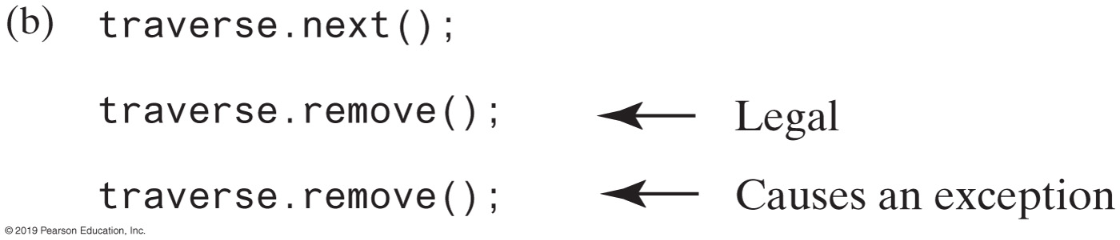
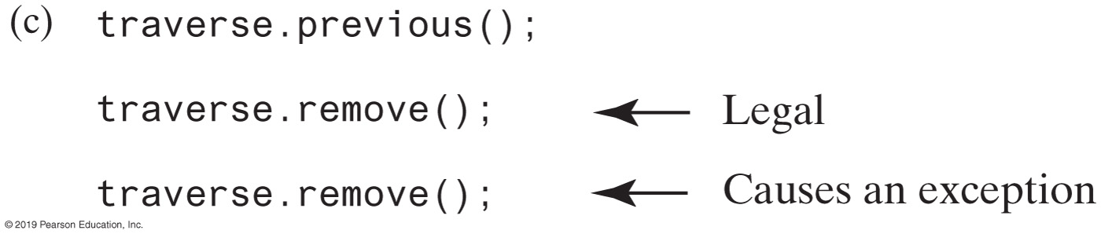
Inner Class Iterator for Array-Based Lists (Part 1)
FIGURE 13-5 Possible contexts in which the method remove of the iterator traversal throws an exception when called

Slide 46
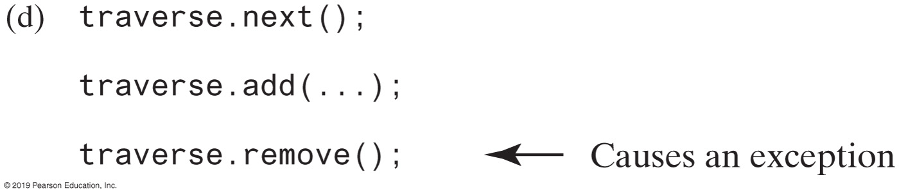
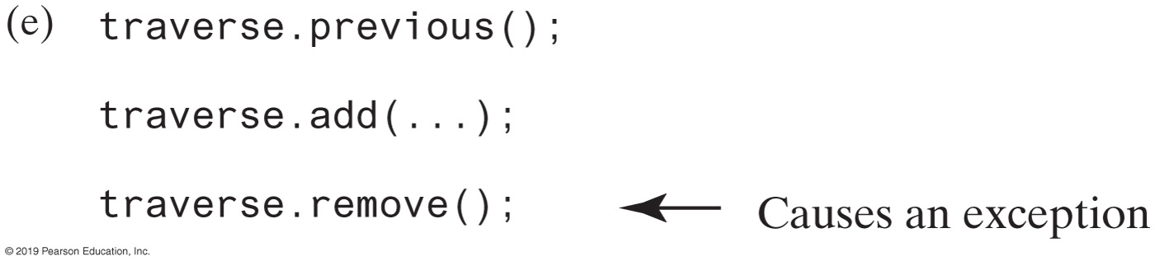
Inner Class Iterator for Array-Based Lists (Part 2)
FIGURE 13-5 Possible contexts in which the method remove of the iterator traversal throws an exception when called

Slide 47
The Inner Class
private enum Move {NEXT, PREVIOUS}
private class ListIteratorForArrayList implements ListIterator<T>
{
private int nextIndex; // Index of next entry in the iteration
private boolean isRemoveOrSetLegal;
private Move lastMove;
private ListIteratorForArrayList()
{
nextIndex = 1; // Iteration begins at list's first entry
isRemoveOrSetLegal = false;
lastMove = null;
} // end default constructor
Beginning of the inner class.

Slide 48
The Inner Class
public boolean hasNext()
{
return nextIndex <= numberOfEntries;
} // end hasNext
Method hasNext.

Slide 49
The Inner Class
public T next()
{
if (hasNext())
{
lastMove = Move.NEXT;
isRemoveOrSetLegal = true;
T nextEntry = list[nextIndex];
nextIndex++; // Advance iterator
return nextEntry;
}
else
throw new NoSuchElementException("Illegal call to next(); " +
"iterator is after end of list.");
} // end next
Implementation of next.

Slide 50
The Inner Class
public boolean hasPrevious()
{
return (nextIndex > 1) && (nextIndex <= numberOfEntries + 1);
} // end hasPrevious
public T previous()
{
if (hasPrevious())
{
lastMove = Move.PREVIOUS;
isRemoveOrSetLegal = true;
T previousEntry = list[nextIndex - 1];
nextIndex--; // Move iterator back
return previousEntry;
}
else
throw new NoSuchElementException("Illegal call to previous(); " +
"iterator is before beginning of list.");
} // end previous
Methods hasPrevious and previous.

Slide 51
The Inner Class
public int nextIndex()
{
int result;
if (hasNext())
result = nextIndex - 1; // Change to zero-based numbering of iterator
else
result = numberOfEntries; // End-of-list flag
return result;
} // end nextIndex
public int previousIndex()
{
int result;
if (hasPrevious())
result = nextIndex - 2; // Change to zero-based numbering of iterator
else
result = -1; // Beginning-of-list flag
return result;
} // end previousIndex
Methods nextIndex and previousIndex

Slide 52
The Inner Class
public void add(T newEntry)
{
isRemoveOrSetLegal = false;
// Insert newEntry immediately before the the iterator's current position
ArrayListWithListIterator.this.add(nextIndex, newEntry);
nextIndex++;
} // end add
The method add.

Slide 53
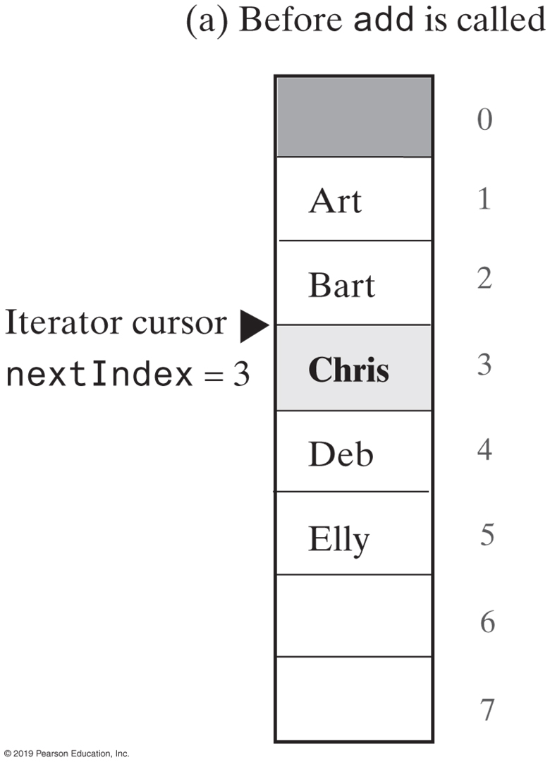
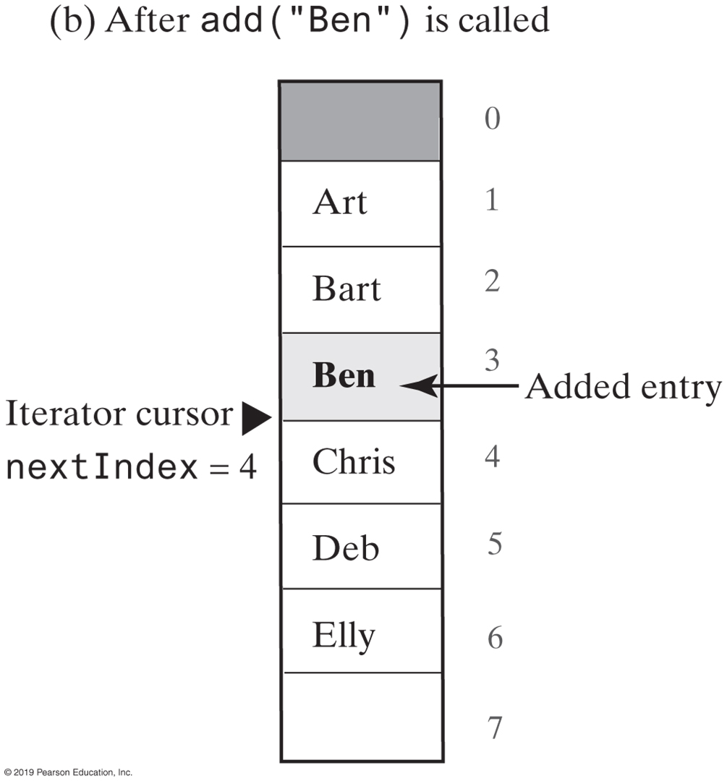
The Inner Class
FIGURE 13-6 Changes to the array of list entries and nextIndex when adding Ben to the list

Slide 54
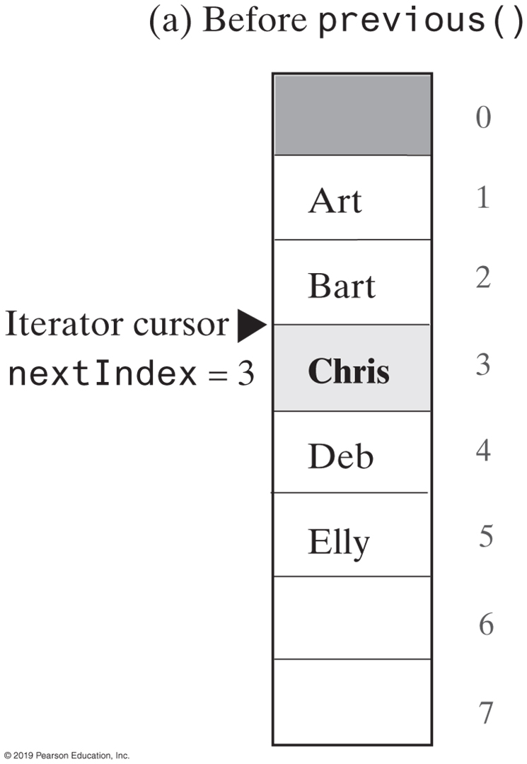
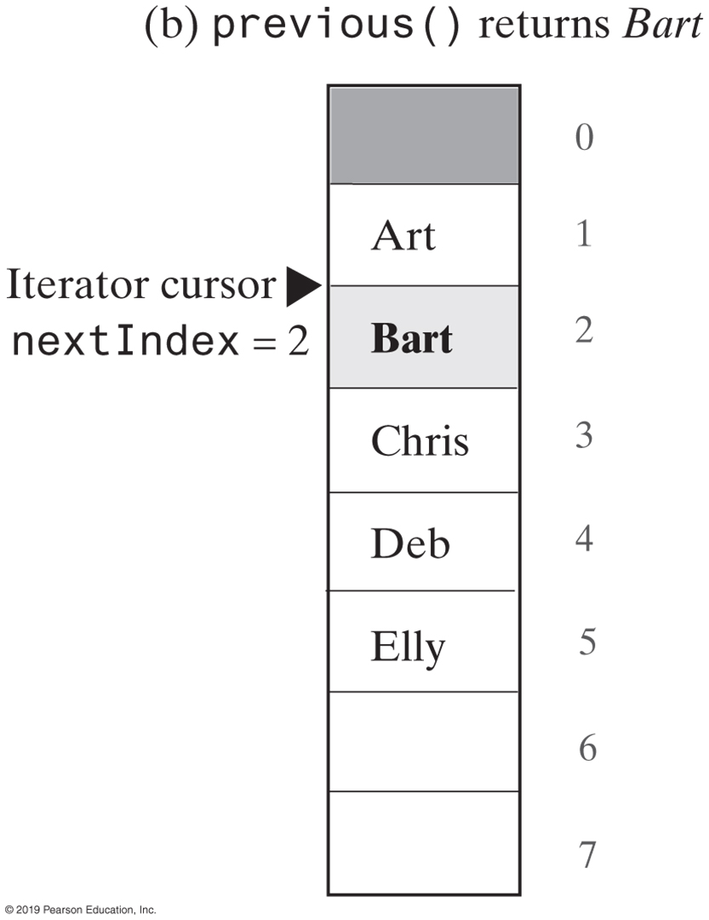
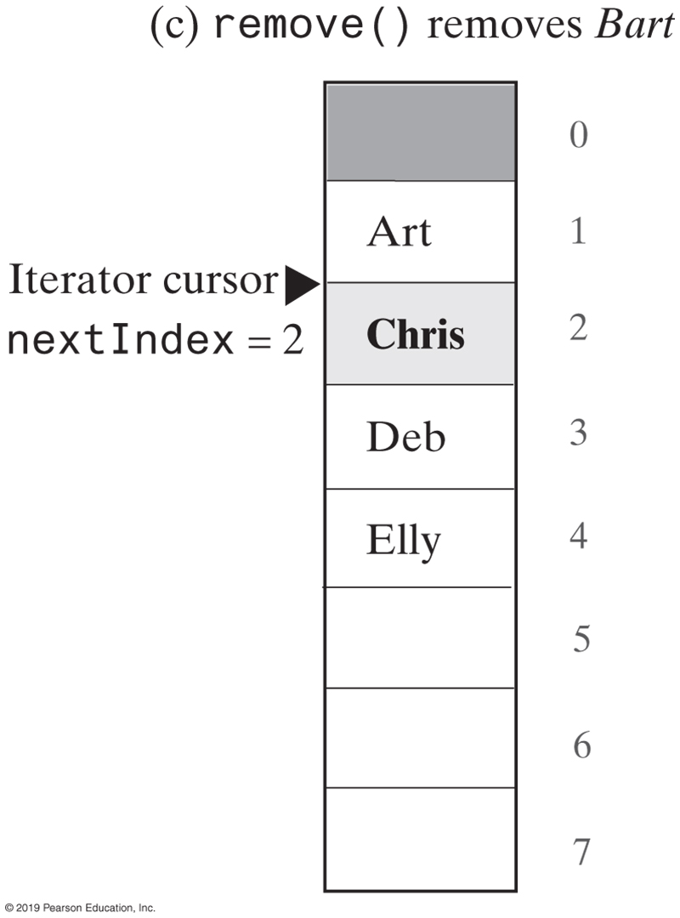
The Inner Class
FIGURE 13-7 Changes to the array of list entries and nextIndex when removing Chris from the list

Slide 55
The Inner Class
public void remove()
{
if (isRemoveOrSetLegal)
{
isRemoveOrSetLegal = false;
if (lastMove.equals(Move.NEXT))
{
// next() called, but neither add() nor remove() has been called since.
// Remove entry last returned by next().
// nextIndex is 1 more than the index of the entry
// returned by next()
ArrayListWithListIterator.this.remove(nextIndex - 1);
nextIndex--; // Move iterator back
}
else
{
// previous() called, but neither add() nor remove() has been called since
// Remove entry last returned by previous().
// nextIndex is the index of the entry returned by previous().
ArrayListWithListIterator.this.remove(nextIndex);
} // end if
}
else
throw new IllegalStateException("Illegal call to remove(); " +
"next() or previous() not called, OR " +
"add() or remove() called since then.");
} // end remove
An implementation of remove.

Slide 56
The Inner Class
public void set(T newEntry)
{
if (isRemoveOrSetLegal)
{
if (lastMove.equals(Move.NEXT))
list[nextIndex - 1] = newEntry; // Replace entry last returned by next()
else
{
// Assertion: lastMove.equals(Move.PREVIOUS)
list[nextIndex] = newEntry; // Replace entry last returned by previous()
} // end if
}
else
throw new IllegalStateException("Illegal call to set(); " +
"next() or previous() not called, OR " +
"add() or remove() called since then.");
} // end set
An implementation of method set.

Slide 57
Interfaces
To appreciate how interfaces can be used to decouple classes
Using interfaces for callbacks

Slide 58
DataSet for Measurable Objects
public class DataSet {
private double sum; private Measurable maximum; private int count; ... public void add(Measurable x) { sum = sum + x.getMeasure(); if (count == 0 || maximum.getMeasure() < x.getMeasure()) maximum = x; count++; } public Measurable getMaximum() { return maximum; } }
public interface Measurable
{
public double getMeasure();
}

Slide 59
Code Reuse
A service type such as DataSet specifies an interface for participating in the service
Use interface types to make code more reusable
Now unrelated classes can use this service by implementing the Measurable interface

Slide 60
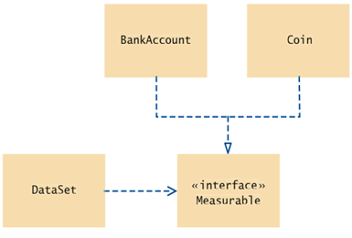
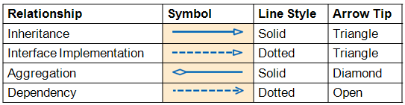
UML Diagram of DataSet and Related Classes
Interfaces can reduce the coupling between classes
UML notation:
Interfaces are tagged with a «interface»
Note that DataSet is decoupled from BankAccount and Coin

Slide 61
1 /**
2 This program tests the DataSet class.
3 */
4 public class DataSetTester
5 {
6 public static void main(String[] args)
7 {
8 DataSet bankData = new DataSet();
9
10 bankData.add(new BankAccount(0));
11 bankData.add(new BankAccount(10000));
12 bankData.add(new BankAccount(2000));
13
14 System.out.println("Average balance: " + bankData.getAverage());
15 System.out.println("Expected: 4000");
16 Measurable max = bankData.getMaximum();
17 System.out.println("Highest balance: " + max.getMeasure());
18 System.out.println("Expected: 10000");
19
20 DataSet coinData = new DataSet();
21
public class DataSet {
private double sum; private Measurable maximum; private int count; ... public void add(Measurable x) { sum = sum + x.getMeasure(); if (count == 0 || maximum.getMeasure() < x.getMeasure()) maximum = x; count++; } public Measurable getMaximum() { return maximum; } }

Slide 62
22 coinData.add(new Coin(0.25, "quarter"));
23 coinData.add(new Coin(0.1, "dime"));
24 coinData.add(new Coin(0.05, "nickel"));
25
26 System.out.println("Average coin value: " + coinData.getAverage());
27 System.out.println("Expected: 0.133");
28 max = coinData.getMaximum();
29 System.out.println("Highest coin value: " + max.getMeasure());
30 System.out.println("Expected: 0.25");
31 }
32 }
public interface Measurable
{
public double getMeasure();
}
public class DataSet {
private double sum; private Measurable maximum; private int count; ... public void add(Measurable x) { sum = sum + x.getMeasure(); if (count == 0 || maximum.getMeasure() < x.getMeasure()) maximum = x; count++; } public Measurable getMaximum() { return maximum; } }

Slide 63
Program Run:
Average balance: 4000.0 Expected: 4000 Highest balance: 10000.0 Expected: 10000 Average coin value: 0.13333333333333333 Expected: 0.133 Highest coin value: 0.25 Expected: 0.25

Slide 64
Suppose you want to use the DataSet class to find the Country object with the largest population. What condition must the Country class fulfill?
Answer: It must implement the Measurable interface, and its getMeasure method must return the population (as a double).

Slide 65
Converting Between Class and Interface Types
You can convert from a class type to an interface type, provided the class implements the interface. Assume BankAccount and Coin both implement Measurable.
BankAccount account = new BankAccount(10000); Measurable x = account; // OK
x holds the address of the BankAccount object
Coin dime = new Coin(0.1, "dime"); Measurable x = dime; // Also OK
x holds the address of the Coin object
Cannot convert between unrelated types:
Measurable x = new Rectangle(5, 10, 20, 30); // ERROR
Because Rectangle doesn’t implement Measurable

Slide 66
Casts
Add Coin objects to DataSet:
DataSet coinData = new DataSet(); coinData.add(new Coin(0.25, "quarter")); coinData.add(new Coin(0.1, "dime")); coinData.add(new Coin(0.05, ”nickel")); Measurable max = coinData.getMaximum(); // Get the largest coin
What can you do with max? It’s not of type Coin:
String name = max.getName(); // ERROR
You need a cast to convert from an interface type to a class type
You know it’s a Coin, but the compiler doesn’t. Apply a cast:
Coin maxCoin = (Coin) max; String name = maxCoin.getName();
maxCoin can now call all the
methods of Coin

Slide 67
If both BankAccount and Coin implement the Measurable interface, can a Coin reference be converted to a BankAccount reference?
Coin x = new Coin(0.25, “quarter”);
BankAccount y = (BankAccount)((Measurable)x);
Answer: No — a Coin reference can be converted to a Measurable reference, but if you attempt to cast that reference to a BankAccount, an exception occurs.

Slide 68
Polymorphism
An interface variable holds a reference to the object of a class that implements the interface:
Measurable meas; meas = new BankAccount(10000); meas = new Coin(0.1, "dime");
Note that the object to which meas refers doesn’t have type Measurable; the type of the object is some class that implements the Measurable interface
From meas you can call any of the interface methods:
double m = meas.getMeasure();

Slide 69
Polymorphism
When the virtual machine calls an instance method, it locates the method of the implicit parameter's class — called dynamic method lookup
If meas refers to a BankAccount object, then meas.getMeasure() calls the BankAccount.getMeasure method
If meas refers to a Coin object, then method Coin.getMeasure is called
Polymorphism denotes the ability to treat objects with differences in behavior in a uniform way

Slide 70
Would the following code segment compile?
DataSet data = new DataSet();
data.add(new BankAccount(1000));
data.add(new Coin(0.1, "dime"));
System.out.println(data.getAverage());
Answer: Yes, however it doesn’t make much sense to find the average of a BankAccount and a Coin
This an example of polymorphism

Slide 71
Using Interfaces for Callbacks
Limitations of Measurable interface:
Can add Measurable interface only to classes under your control
Can measure an object in only one way
E.g., cannot analyze a set of savings accounts both by bank balance and by interest rate
Callback: a mechanism for specifying code that is executed at a later time (a mechanism for adding functionality to a class that you don’t have implementation control of)
In previous DataSet implementation, responsibility of measuring lies with the added objects themselves

Slide 72
Using Interfaces for Callbacks
Alternative: Hand the object to be measured to a method of an interface:
public interface Measurer { double measure(Object anObject); }
Object is the “lowest common denominator” of all classes
All objects “inherit” from the Object class. All objects are “related” through the Object class. All classes have some common methods that they “inherit” from the Object class.

Slide 73
Using Interfaces for Callbacks
The code that makes the call to the callback receives an object of the class that implements this interface:
public DataSet(Measurer aMeasurer)
{
sum = 0;
count = 0;
maximum = null;
measurer = aMeasurer; // Measurer instance variable
}
The measurer instance variable carries out the measurements:
public void add(Object x)
{
sum = sum + measurer.measure(x);
if (count == 0 || measurer.measure(maximum) < measurer.measure(x))
maximum = x;
count++;
}

Slide 74
Using Interfaces for Callbacks
A specific callback is obtained by implementing the Measurer interface:
public class RectangleMeasurer implements Measurer { public double measure(Object anObject) { Rectangle aRectangle = (Rectangle) anObject; double area = aRectangle.getWidth() * aRectangle.getHeight(); return area; } }
Must cast from Object to Rectangle:
These signatures
must match
public interface Measurer { double measure(Object anObject); }

Slide 75
Measurer m = new RectangleMeasurer(); DataSet data = new DataSet(m); data.add(new Rectangle(5, 10, 20, 30)); data.add(new Rectangle(10, 20, 30, 40));
...
public DataSet(Measurer aMeasurer)
{ measurer = aMeasurer;
. . .
public void add(Object x)
{
sum = sum + measurer.measure(x);
if (count == 0 || measurer.measure(maximum) < measurer.measure(x))
maximum = x;
count++;
}
}
public class RectangleMeasurer implements Measurer { public double measure(Object anObject) { Rectangle aRectangle = (Rectangle) anObject; double area = aRectangle.getWidth() * aRectangle.getHeight(); return area; } }

Slide 76
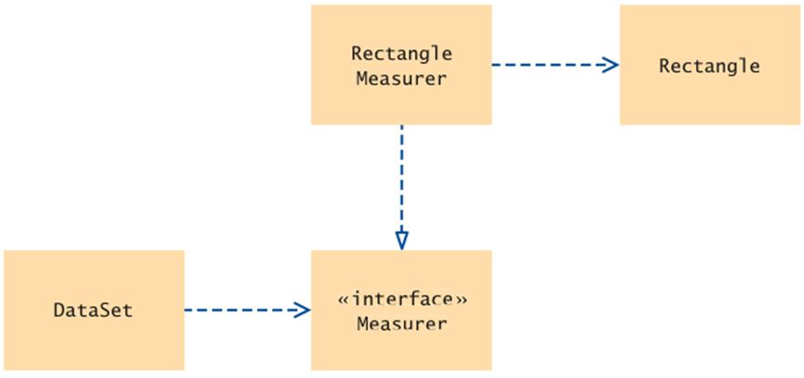
UML Diagram of Measurer Interface and Related Classes
Note that the Rectangle class is decoupled from the Measurer interface

Slide 77
What if I wanted to use as a “measure”, the width of the Rectangle, or the height, instead of the area?
Create two additional classes that implement Measurer
public class RectangleWidthMeasurer implements Measurer { public double measure(Object anObject) { Rectangle aRectangle = (Rectangle) anObject; return aRectangle.getWidth(); } }
public class RectangleHeightMeasurer implements Measurer { public double measure(Object anObject) { Rectangle aRectangle = (Rectangle) anObject; return aRectangle.getHeight(); } }

Slide 78
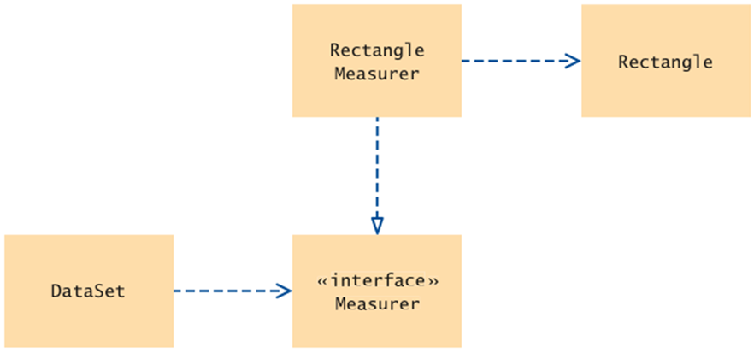
RectangleHeight
Measurer
Can I have one DataSet that uses all three Measurers?
public DataSet(Measurer aMeasurer)
{
. . .
}
RectangleWidth
Measurer
No

Slide 79
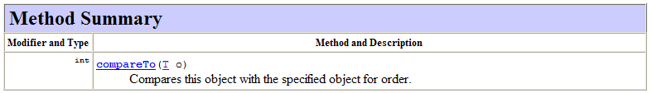
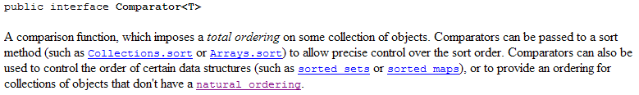
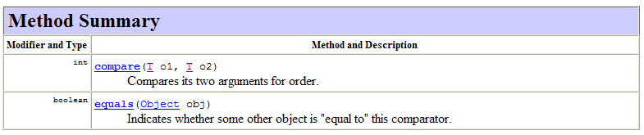
Comparable vs. Comparator Interfaces
Comparable Interface
Comparator Interface – used for Callbacks

Slide 80
import java.awt.Rectangle;
import java.util.Comparator;
public class RectangleComparator implements Comparator <Rectangle>
{
public int compare(Rectangle first, Rectangle second)
{
double firstArea = first.getHeight() * first.getWidth();
double secondArea = second.getHeight() * second.getWidth();
if(firstArea == secondArea) return 0;
else if (firstArea > secondArea) return 1;
else return -1;
}
public boolean equals(Rectangle anObject)
{
Object thisObject = (Object)this;
Rectangle thisRec = (Rectangle)thisObject;
if(this.compare(thisRec,anObject)==0) return true;
else return false;
}
}

Slide 81
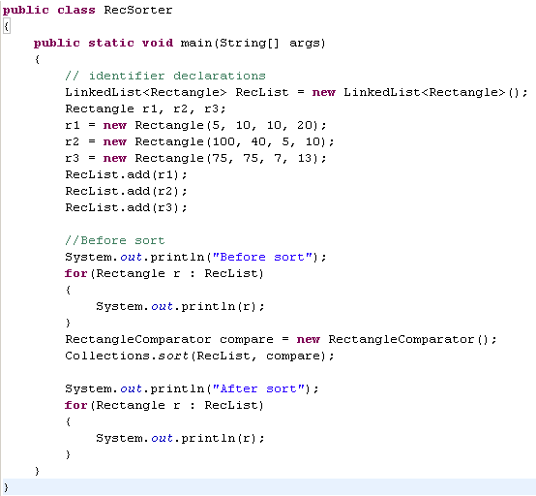
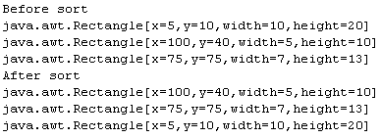

Slide 82
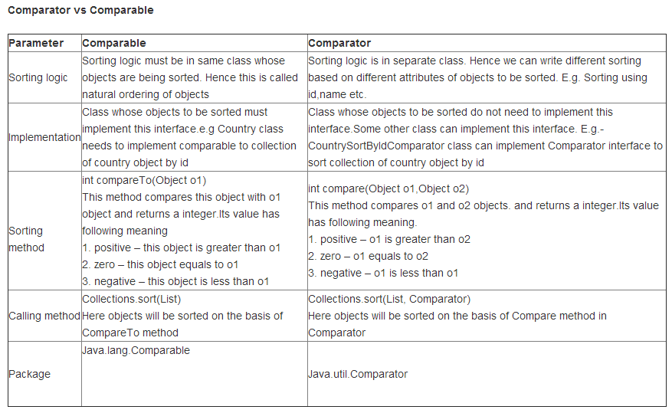
http://www.javacodegeeks.com/2013/03/difference-between-comparator-and-comparable-in-java.html

Slide 83
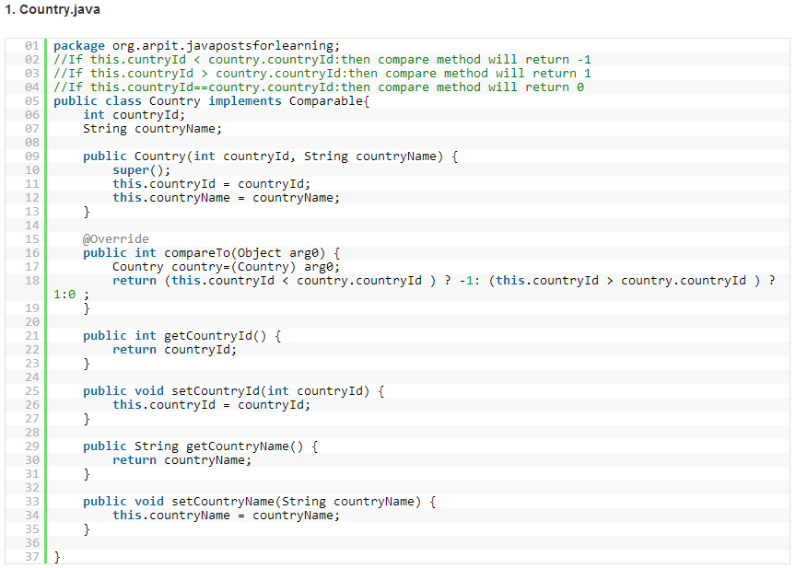
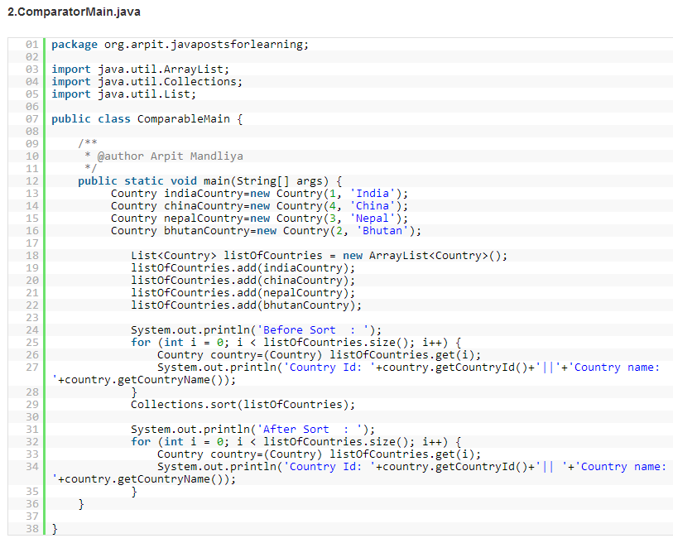
http://www.javacodegeeks.com/2013/03/difference-between-comparator-and-comparable-in-java.html

Slide 84
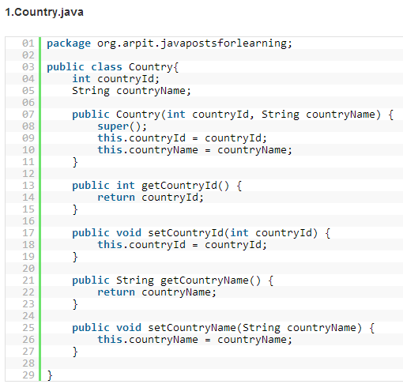
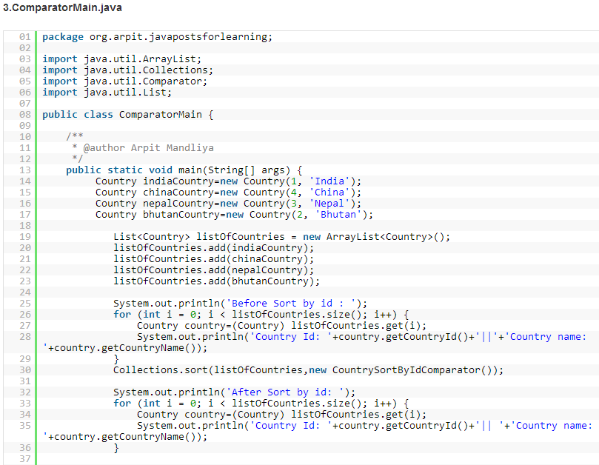
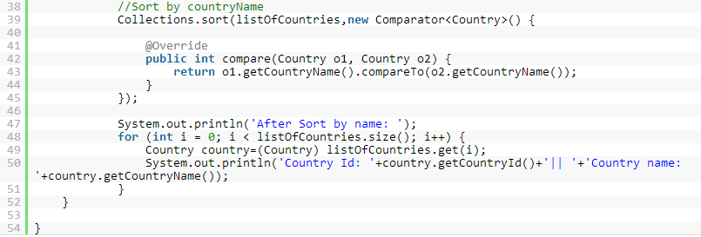
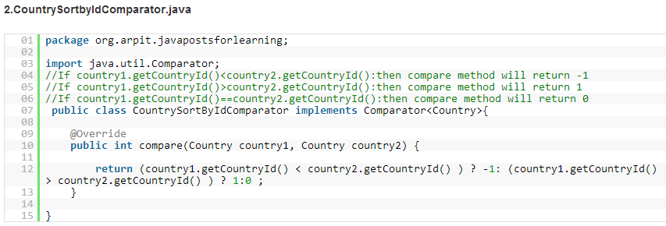
http://www.javacodegeeks.com/2013/03/difference-between-comparator-and-comparable-in-java.html

